Slide 1
Introduction to Enterprise Networks
CSCI 7000
Virtual LANs (VLANs)
Jose Santos
Network Engineering @ Computer Science

Slide 2
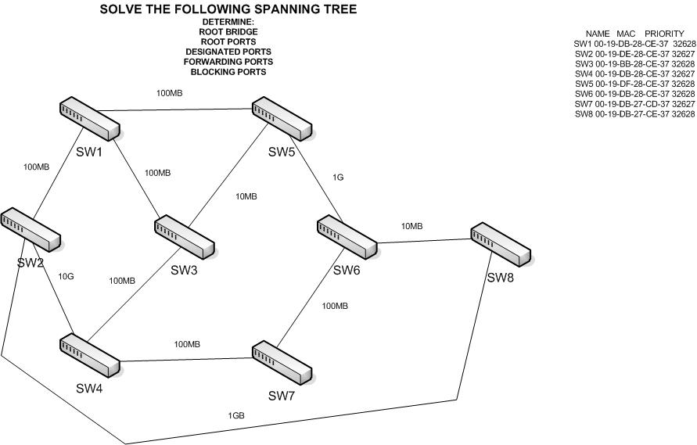

Slide 3
STP
Pros
  Layer 2 redundancy
  Loop Prevention
Cons
  Suboptimal L2 forwarding

Slide 4
VLAN
Virtual LAN:
  Broadcast domain created by 1 or more switches
  A switch can separate ports in groups each becoming its own BD. Cost effective.
Usage (draw)
  Grouping common stations
  Security
  Limiting size of Broadcast Domains
  Separate Specialized traffic

Slide 5
VLAN usage

Slide 6
VLAN Configuration
Port-based VLANs
  Easy to configure, must keep track of stations
MAC based VLANs
  Portability vs. admin overhead

Slide 7
Trunking (draw)
Connection between 2 switches, designed to propagate VLAN information when supporting VLAN members in more than 1 switch.
Frames exchanged between switches are tagged in order to determine to which VLAN they belong to.
Cisco Switches support the following trunking protocols:
  Inter-switch link (ISL) and 802.1q

Slide 8
Trunking

Slide 9
ISL
Proprietary Protocol
Fully encapsulates each Ethernet frame in a ISL header (26 bytes) and trailer (4 bytes)
DA/SA from sending and receiving switch
VLAN ID (12 bits)
ISL HDR
ENCAPSULATED ETH FRAME
CRC
DA
Type
User
SA
LEN
AAAA03
HSA
VLAN
BPDU
INDEX
RES

Slide 10
IEEE 802.1q
Does not encapsulate, it adds an extra 4 byte header to the middle of the original Ethernet header
As original header changes, it forces a FCS recalculation
Preamble
DA
SA
Type
Data
FCS
TAG
Priority
VLAN ID

Slide 11
ISL vs. 801q
Both use a 12 bit VLAN ID
Both support a separate instance of spanning tree for each VLAN (draw)
  Per-VLAN Spanning Tree (PVST+)
  IEEE 802.1S
  Better link utilization
Native VLAN difference
  Designed to support devices that don’t understand 801.q while still supporting multiple VLANs on a single link.
  801.q defines 1 VLAN per trunk as native. Defaults to VLAN1
  801.q does not insert a header in the frame
  ISL does not uses this concept, it tags all frames on a trunk

Slide 12
VLAN Trunking Protocol (VTP)
Proprietary
L2 messaging protocol designed to exchange VLAN info between switches for consistency
Reduces management overhead
VTP Server:
  Distributes VLAN changes as broadcast to all other VTP Clients and servers, both hear the VTP messages and update their configuration/
  VTP floods advertisements every 5 minutes or whenever there is a change in configuration
Advertisements include:
  Configuration revision number, VLAN names and numbers, and info about port assignment per VLAN per SW

Slide 13
VTP Operation Modes
Server
  Switches configured as VTP servers can create, modify and delete VLANs and other parameters for the entire VTP domain
  Save their configuration on NVRAM
Client
  Obey VTP server config updates.
  Cannot do what a VTP server does.
Transparent
  “Disables” VTP in Cisco SW. A SW simply ignores the VTP messages but still forwards them.
  Used on networks with distributed administration control
VTP Pruning : Prevents broadcast and unknown unicast flow to switches w/o any ports on a specific VLAN

Slide 14
Inter-VLAN Communication
Layer 2 Switching
  Cannot forward traffic between VLANs, just within them
Layer 3 Forwarding (Router)
  Each VLAN corresponds to a different subnet
  The router needs an interface on each subnet to forward traffic between them – wasteful
  Instead you can use a FastE Interface that support trunking (now we expand trunking concept)
Layer 3 Forwarding (Switch)
  Switch with routing capabilities
  Forwarding on basis of L3 IP routing table
  Specialized ASICs make forwarding process very fast ($$$)

Slide 15
Router on a Stick

Slide 16
Inter-VLAN Communication
Layer 4 Switching
  Use of TCP and UDP header info for forwarding
  Example: Replicated Servers with single IP
  Switch must keep track of every individual layer 4 flow
  NetFlow feature on some Cisco Switches
Layer 5-7 Switching / application layer switching
  Content Delivery Networks
Multilayer Switching
  Performs switching at multiple layers (Idem L3 switch)
    L2 switching within VLANs
    L3 Switching between VLANs

Slide 17
PVST
Per-VLAN STP

Slide 18
Layer 2 Wrap-up

Slide 19
IP Addressing
Part 1: INTRO

Slide 20
IP Address Review
Dotted decimal (0 – 255)
  1.2.3.4
Binary
  0000 0001. 0000 0010. 0000 0011. 0000 0100
Binary AND
    0 AND 0 = 0
    0 AND 1 = 0
    1 AND 0 = 0
    1 AND 1 = 1

Slide 21
Classful Addressing
 | Range | Valid Network Numbers | NET/HOST Bytes | # Nets | #Hosts
A | 1-126 | 1.0.0.0 126.0.0.0 | 1 / 3 | 2^7 - 2 | 2^24 -2
B | 128 - 191 | 128.1.0.0 191.254.0.0 | 2 / 2 | 2^14 - 2 | 2^16 - 2
C | 192 - 223 | 192.0.1.0 223.255.254.0 | 3 / 1 | 2^21 - 2 | 2^8 - 2

Slide 22
Reserved Networks
Original Broadcast
  0.0.0.0
Loopback
  127.0.0.0
Others
  128.0.0.0
  191.255.0.0
  192.0.0.0
  223.255.255.0
First and Last of each class

Slide 23
Network Mask
Helps to determine the network and host parts of an IP address
Default masks
  Class A (1/3)
    255.0.0.0
    1111 1111.0000 0000.0000 0000. 0000 0000
  Class B (2/2)
    255.255.0.0
    1111 1111.1111 1111.0000 0000. 0000 0000
  Class C (3/1)
    255.255.255.0
    1111 1111.1111 1111.1111 1111. 0000 0000

Slide 24
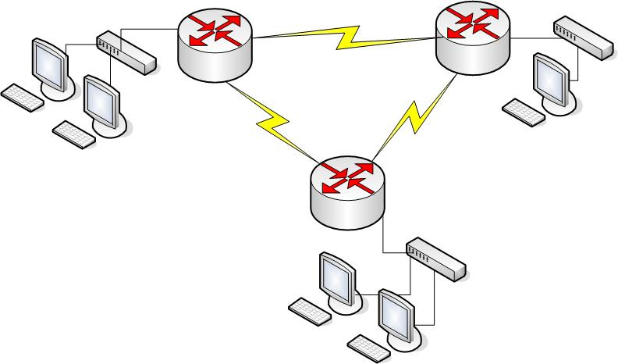
Classful Diagram
130.11.0.0
130.10.0.0
130.13.0.0
130.15.0.0
130.14.0.0
130.12.0.0

Slide 25
Classful diagram
6 Class B networks
  2^16 – 2 = 65K! addresses x network
If Class C
  2^8 – 2 = 254 addresses x network

Slide 26
Subnetting
Subdivide a classful network into smaller groups/subnets
Any subnet is treated as a different network
Subnets don’t overlap

Slide 27
Subnetting Diagram
130.10.3.0
130.10.1.0
130.10.2.0
130.10.4.0
130.10.6.0
130.10.5.0

Slide 28
Subnetting diagram
1 Class B network address with a Class C mask
  Classful
    130.10.0.0 255.255.0.0
  Subnetting
    130.10.X.0 255.255.255.0
Use some of the host bits to create subnet numbers

Slide 29
Address Formats
Class A
Network
Subnet
Host
Class B
Network
Network
Subnet
Host
Class C
Network
Network
Network
Subnet
Host

Slide 30
Next Class
Wireless LANs, MLS, IRB, BVI
Read links on Syllabus

